Slide 1


Integrated Aquaculture-Agriculture Soil Enrichment System (IAASES)
K200286 – Syed Aun Ali
K200421 – Muhammad Fahad Zahid
K200273 – Muhammad Mudabbir
Department of Computer Science, FAST-NUCES, Karachi, Pakistan

Slide 2
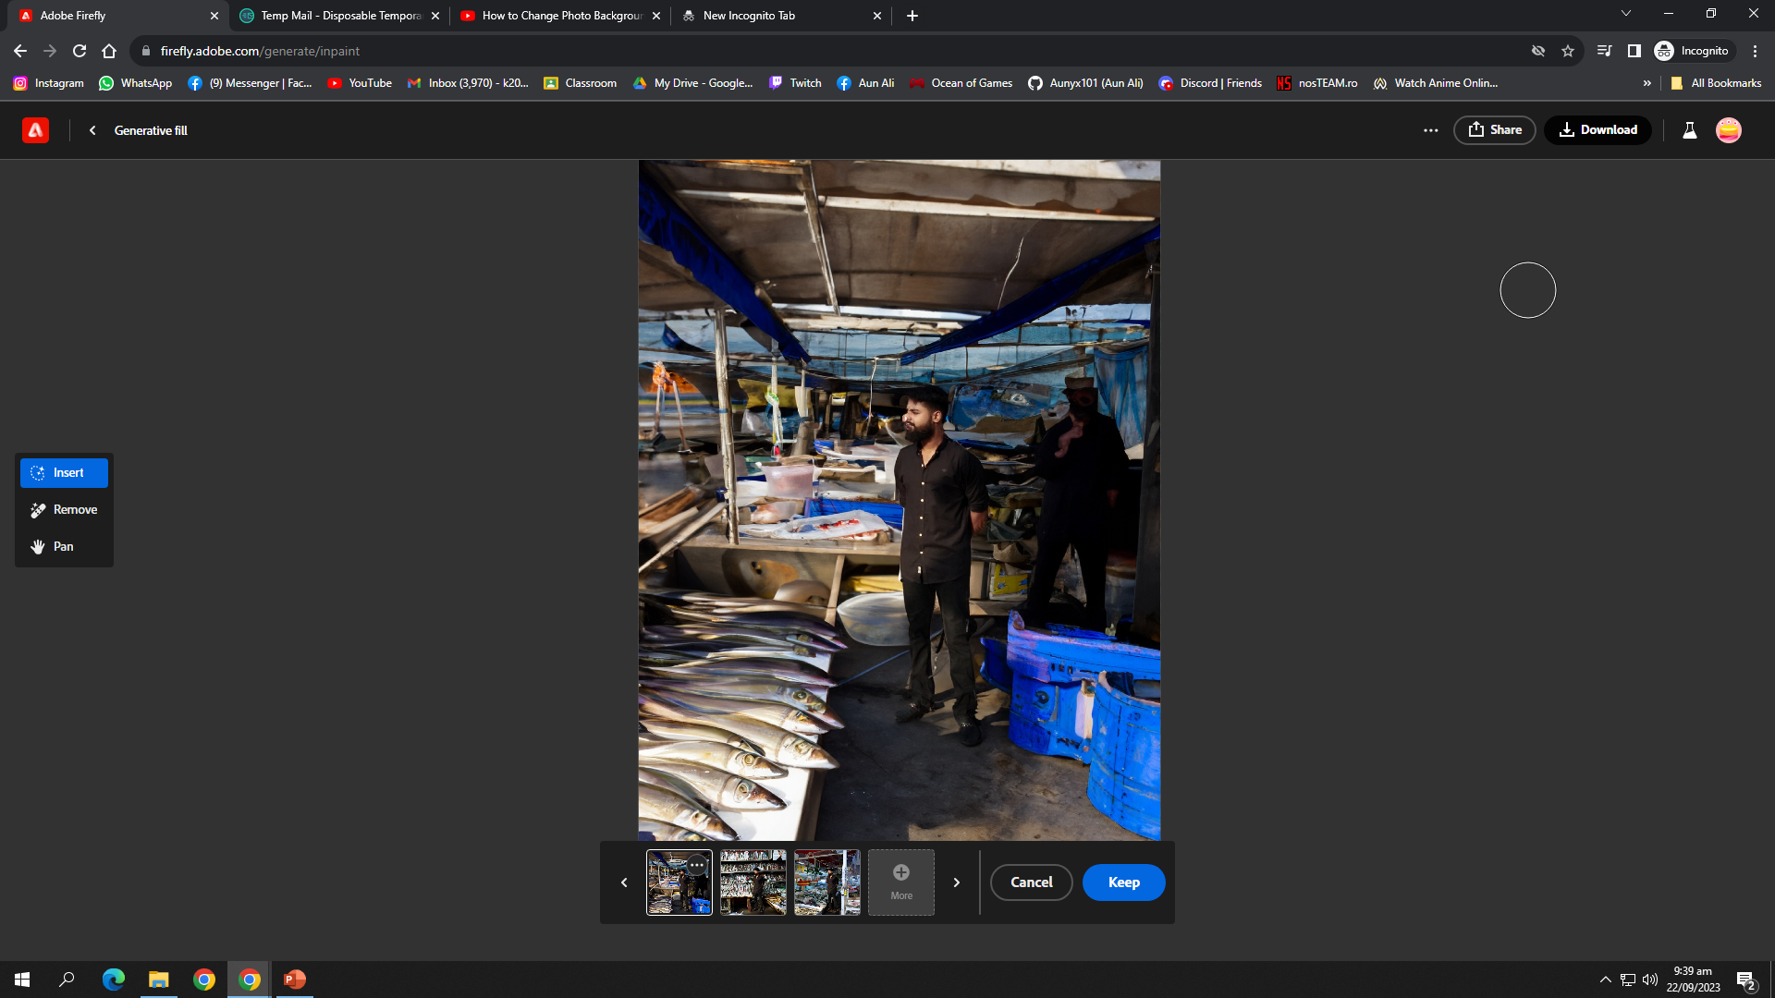
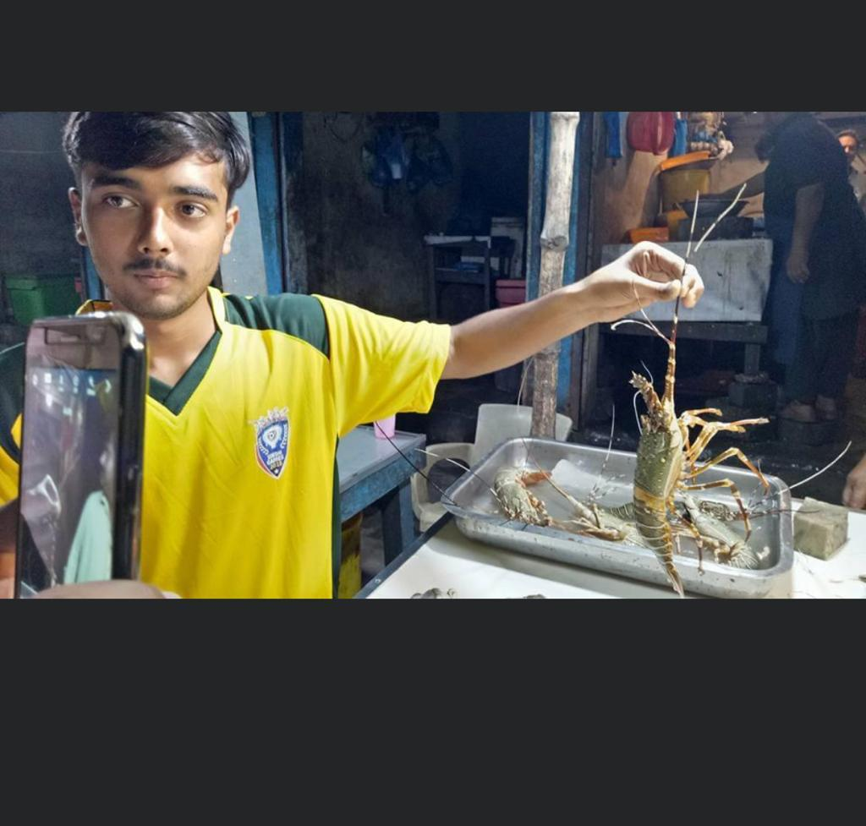
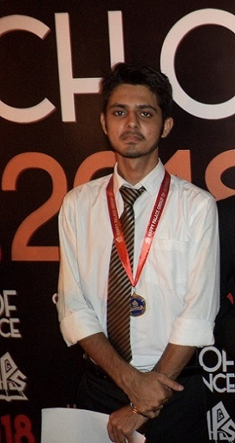
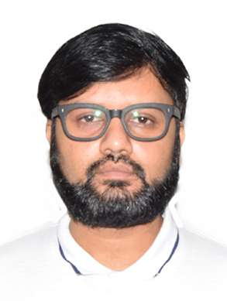
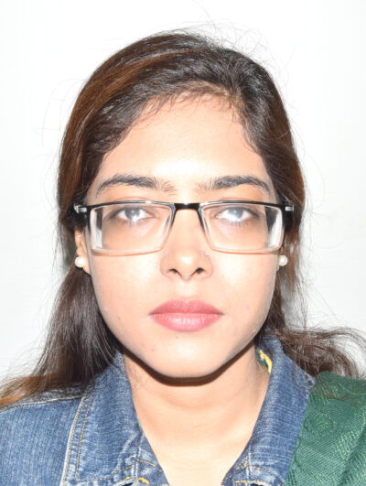
Team
Syed Aun Ali (K200286)
M. Mudabbir (K200273)
M. Fahad (K200441)
▲Collecting Dataset
Dr. Muhammad Farrukh Shahid , PhD
Ms. Sania Urooj
Assistant Professor
Co - Supervisor
Lecturer
Supervisor

Slide 3
Roadmap
Introduction
Problem Statement
Scenario Comparison
Jury Feedback Form (FYP-II Mids)
Fish Dataset Collection
Fish Classification Flow Diagram
Fish Classification Model Results
Soil Dataset Collection
Soil Classification Model
Soil Classification Model Results
Soil Classification Flow Diagram
Fish to Soil (& Vice Versa) Mapper
Fish Details At Classification
LLM For Nutrient Extraction Procedure
Frontend (User Interface)
Contributions Towards Society
Documentation
Conclusion

Slide 4
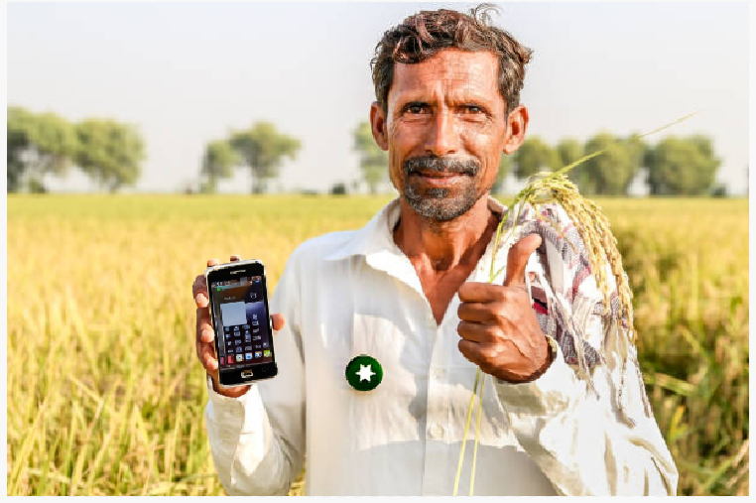
Introduction
Integrated Aquaculture-Agriculture Soil Enrichment System (IAASES): Bridging Sustainability Through Nutrient-Rich Solutions
Focuses on bridging the gap between aquaculture and agriculture using modern technology.
The primary objective is to develop an automated system for soil enrichment by integrating fish hydrolysate (and many other soil enrichment via fishery techniques) with compatible fish species.
This project addresses the growing need for sustainable soil enrichment methods, particularly in the context of agriculture in Pakistan.
Analyzing data using AI and CV models

Slide 5
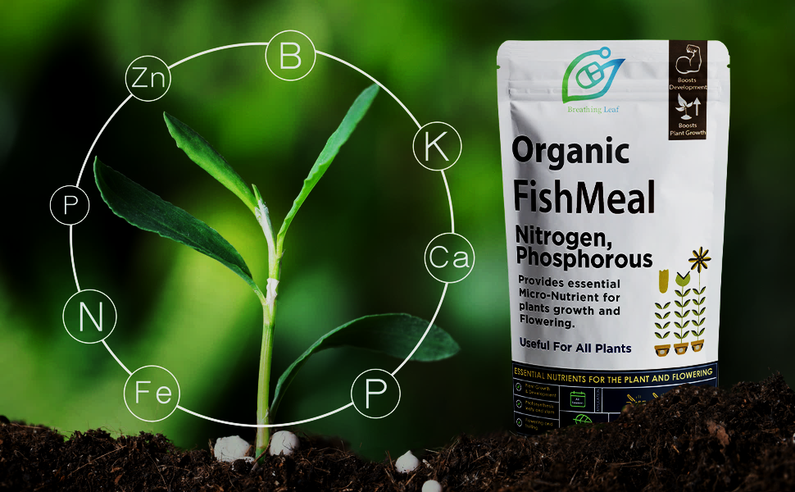
Problem Statement
In Pakistan, traditional agricultural practices and soil enrichment methods face significant challenges, including nutrient-poor soils and a lack of specifically tailored recommendations for farmers. Our project aims to develop a innovative system that bridges aquaculture and agriculture together and provide farmers with AI-driven solutions for soil enrichment.

Slide 6
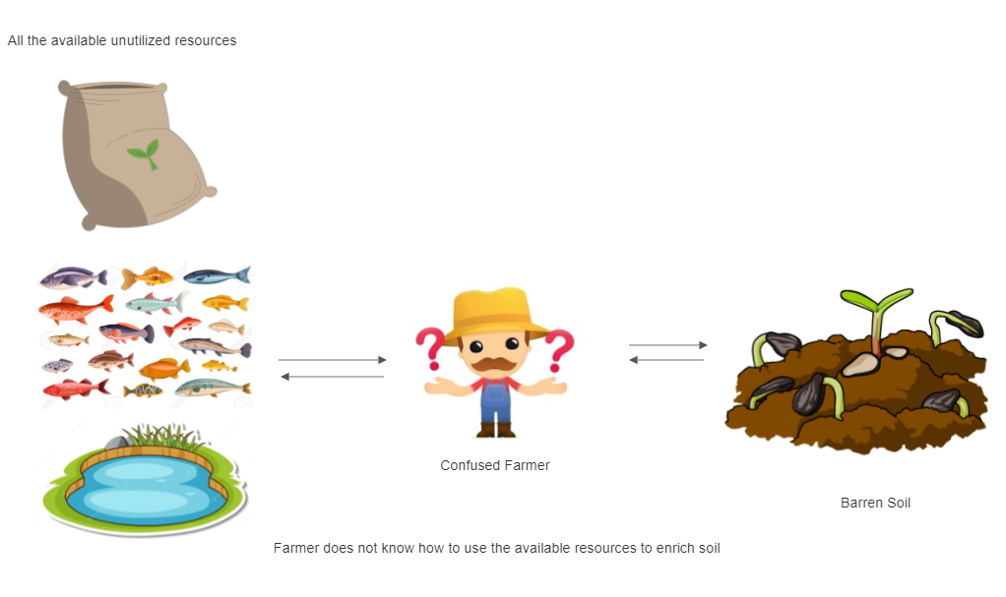
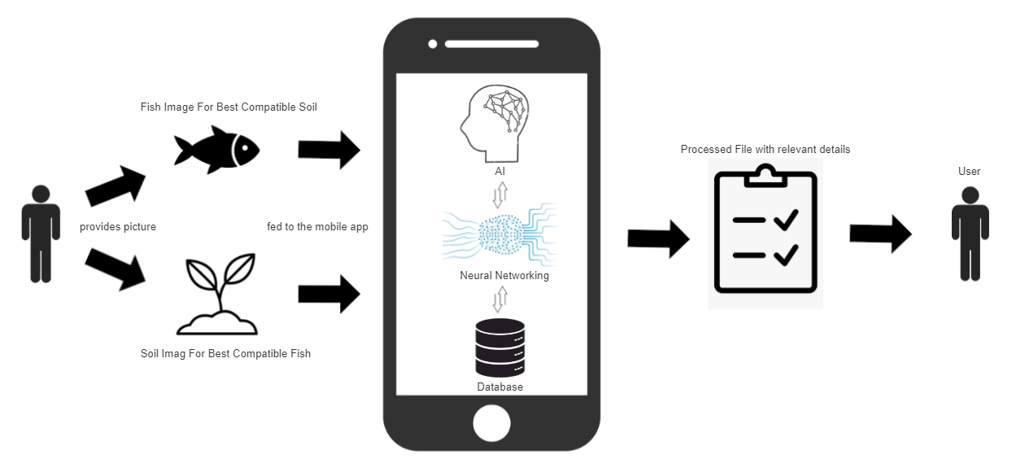
All the available unutilized resources
Current Scenario:
Confused Farmer
Barren Soil
Farmer does not know how to use the available resources to enrich soil
Fish image for best compatible soil
Proposed Scenario:
Processed file with relevant details
Provides picture
User
User
Analyzing data using AI and CV models
Soil image for best compatible fish

Slide 7
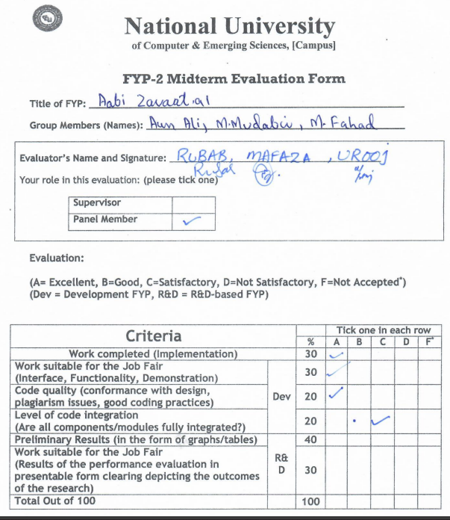
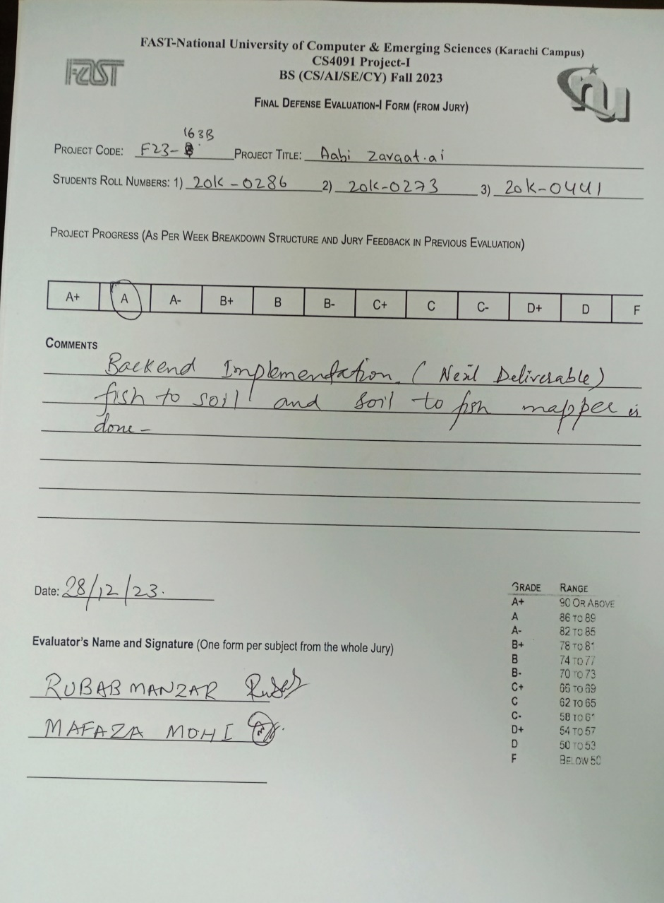
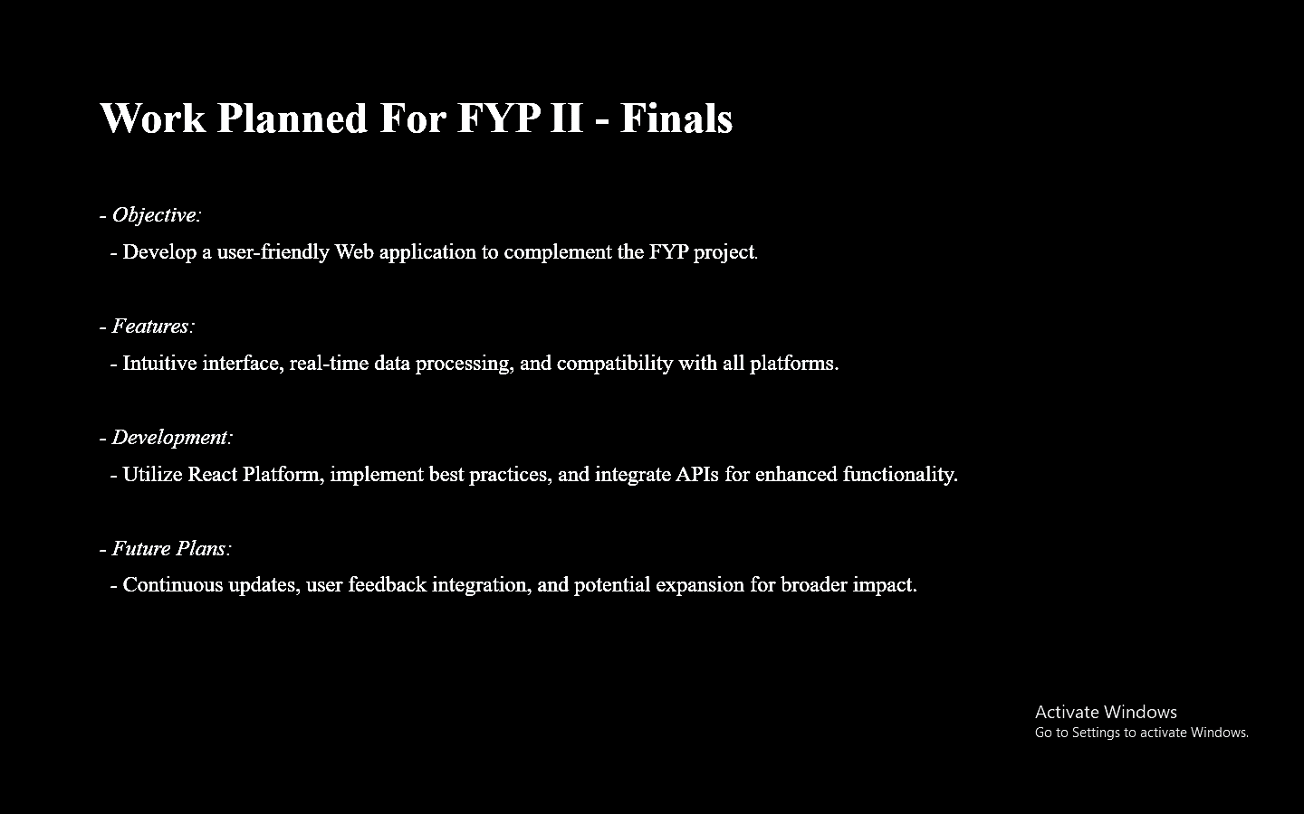
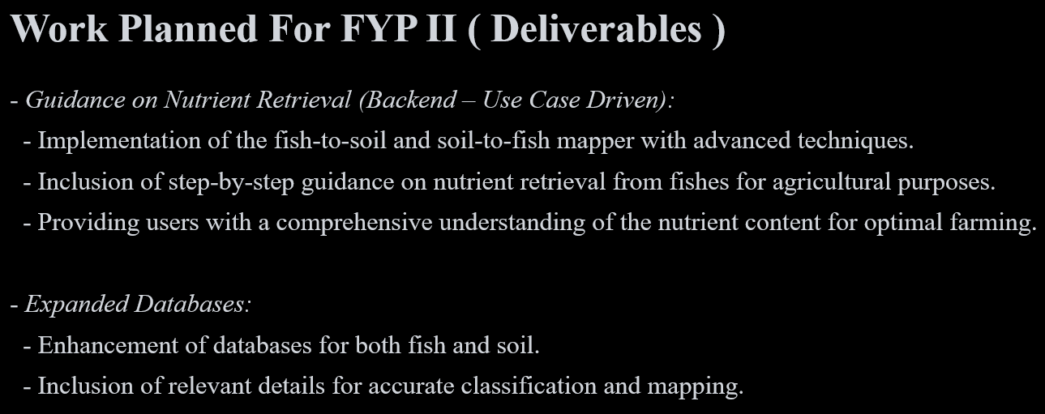
Jury Feedback Form & Deliverables From FYP – II Mids
Analyzing data using AI and CV models
△ Taken From FYP – II Mid’s Presentation

Slide 8
Methodology
Employed machine learning and computer vision techniques for soil and fish classification.
Collected and analyzed data on soil types and nutrient requirements.
Integrated a system that is data-driven in decision-making for fish compatibility recommendations.
Explored and researched on various fish-soil enrichment techniques, including Fish Emulsion, Fish Meal, Fish Composting, Fish Silage, Vermicomposting with Fish Waste, Aquaponics, and the fish hydrolysate procedure.
Enable users to select their soil/fish type and receive recommendations for most compatible fish/soil.

Slide 9
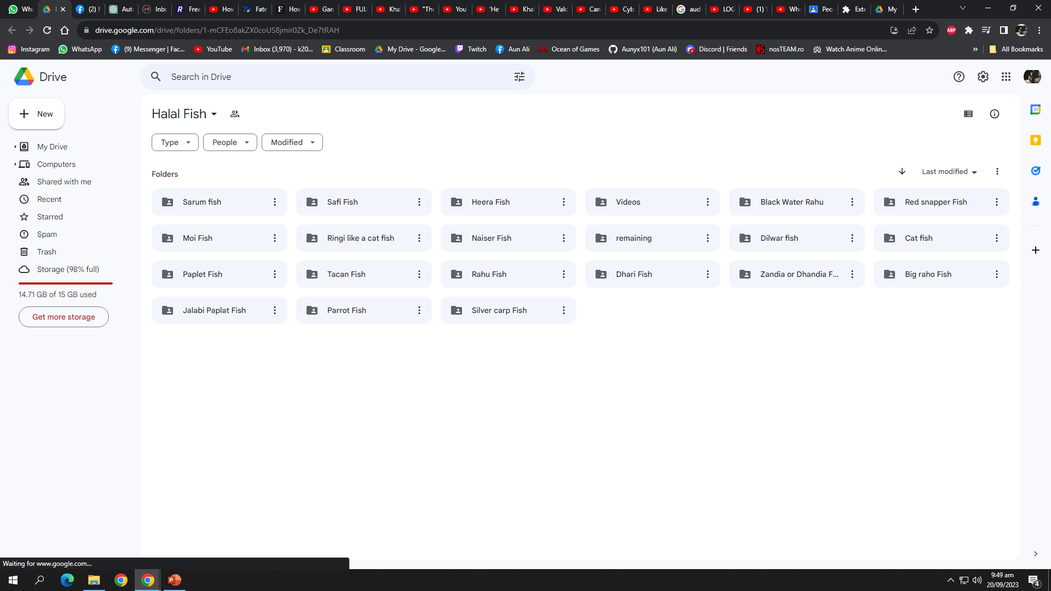
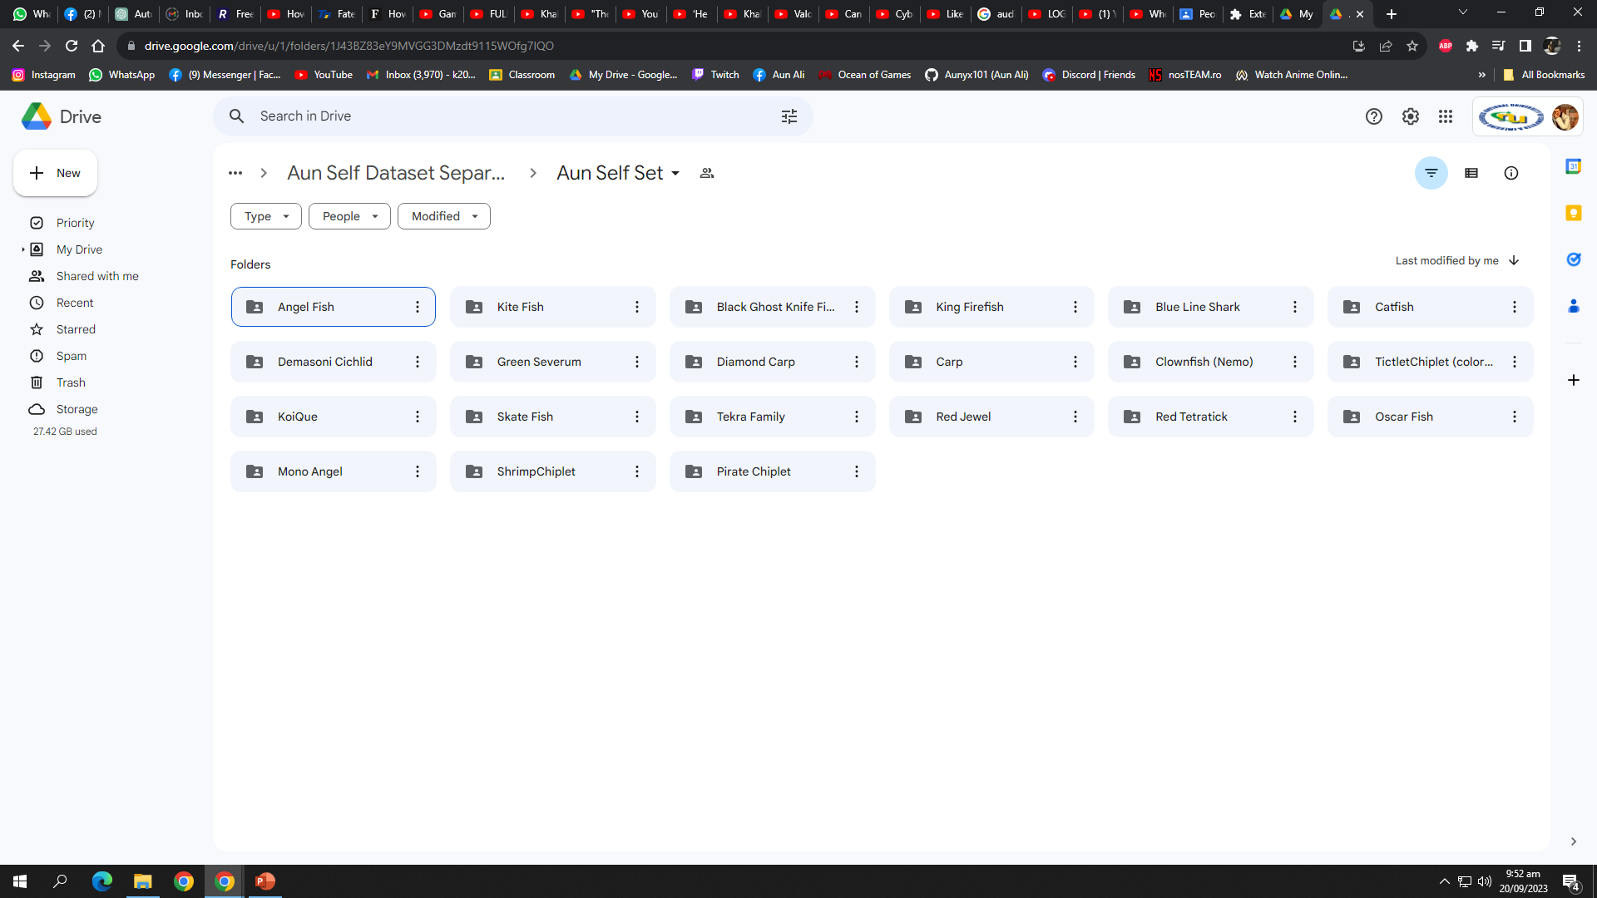
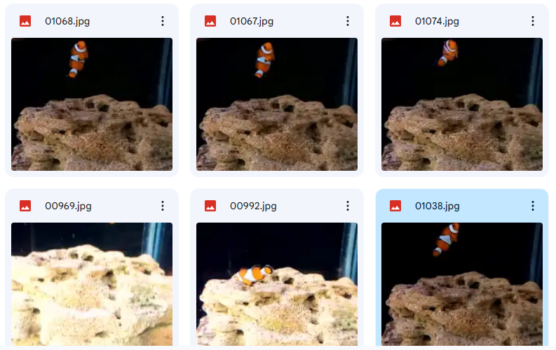
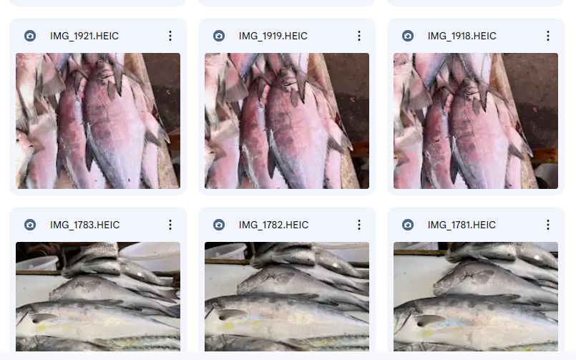
Fish Dataset Collection
Rich dataset on local fish species.
Extensive efforts in data collection.
Diverse representation of fish species.
Collaborative engagement with local
communities and fishermen.

Slide 10

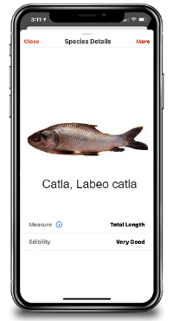
Fish Classification Methodology Flow Diagram
Dataset
Feature Extraction
Deep Learning Models
Trained Models
Training
Testing
Train Set
Testing Processing
Pre-Processing
Trained Models
Model Performance Evaluation
Classification
Train Set
Testing Processing
Fig 1 Block Diagram of the proposed methodology

Slide 11
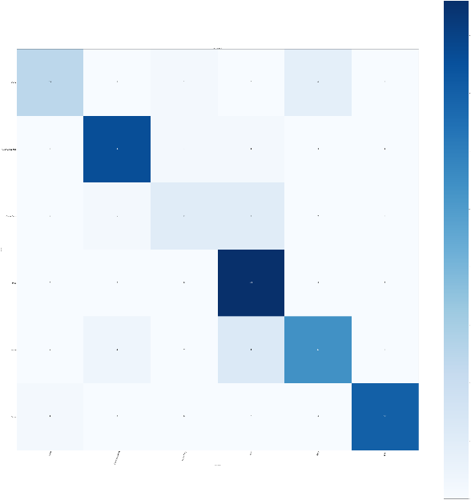
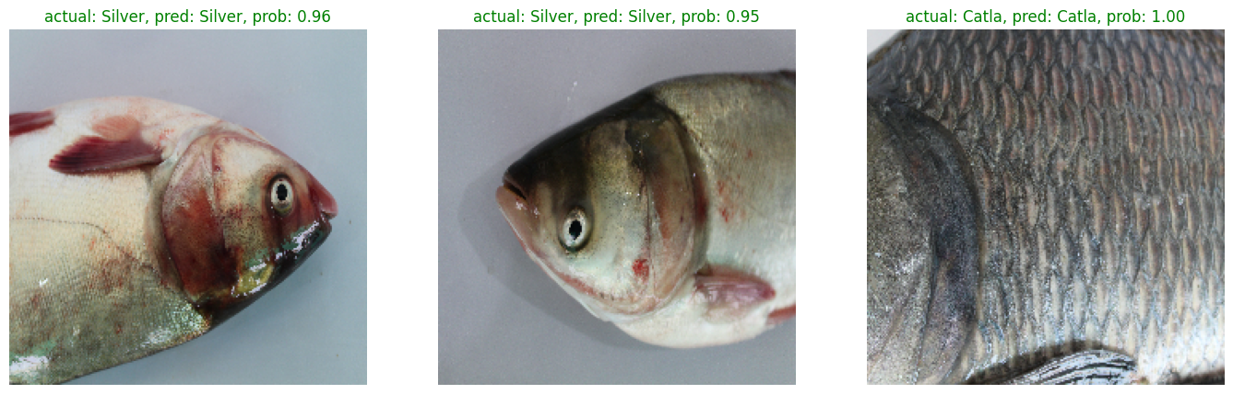
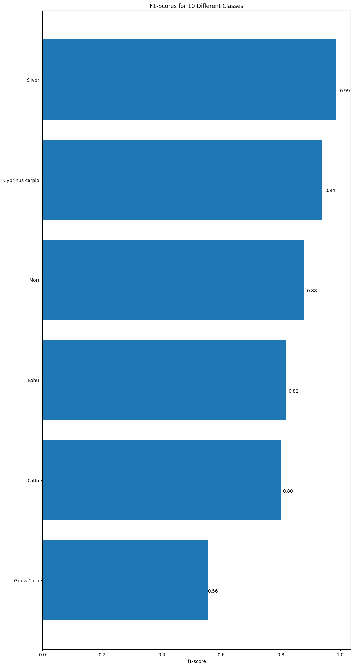
Fish Classification Model Results
The mobile application successfully classifies soil types and fishes using smartphone cameras.
Users can receive recommendations for compatible and protein-rich fish species for soil enrichment.
The application automates the fish hydrolysate system (and other techniques), facilitating nutrient and protein enrichment.
A user-friendly interface for smooth and seamless access to application’s features.
Confusion Matrix
Prediction
F1 - Score

Slide 12
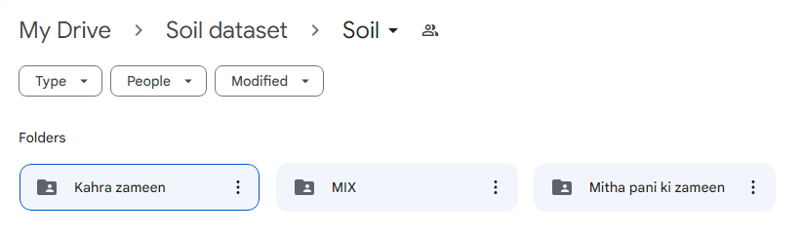
Soil Dataset Collection
Rich dataset on local Soil (Sindh).
Extensive efforts in data collection.
Diverse representation of different kinds of soil.
Collaborative engagement with local communities and farmers.

Slide 13
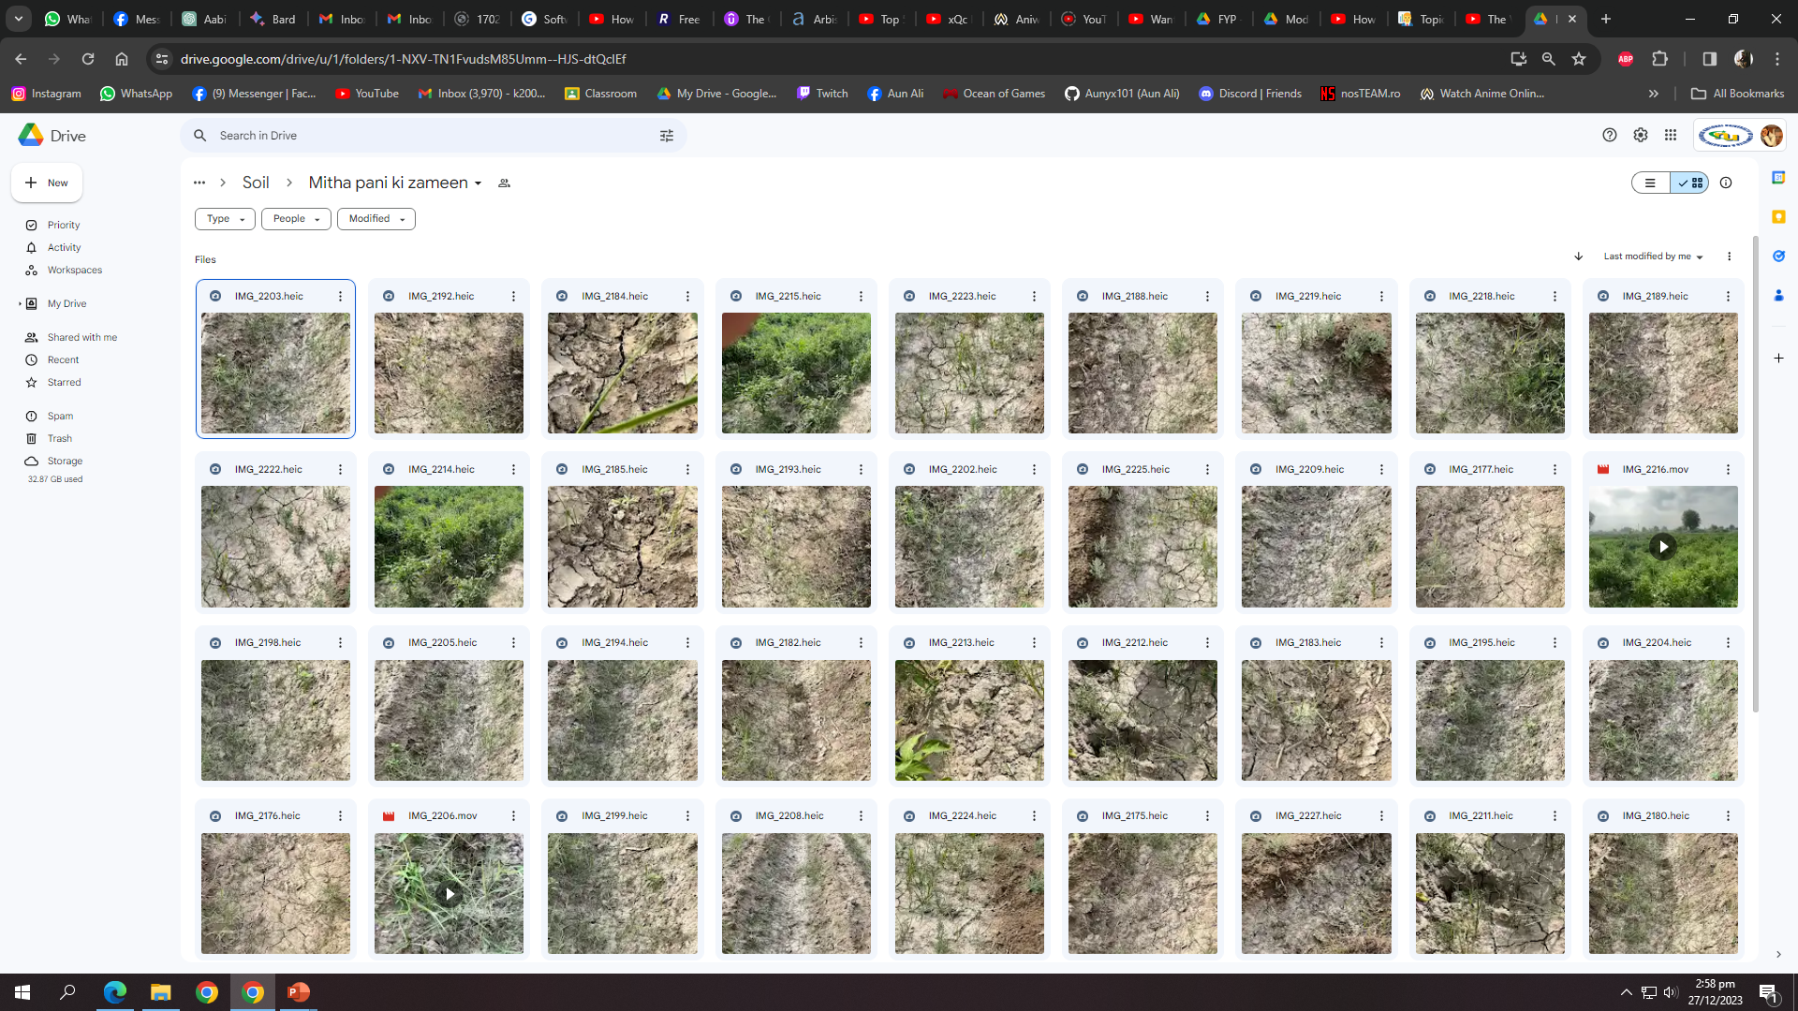

Slide 14
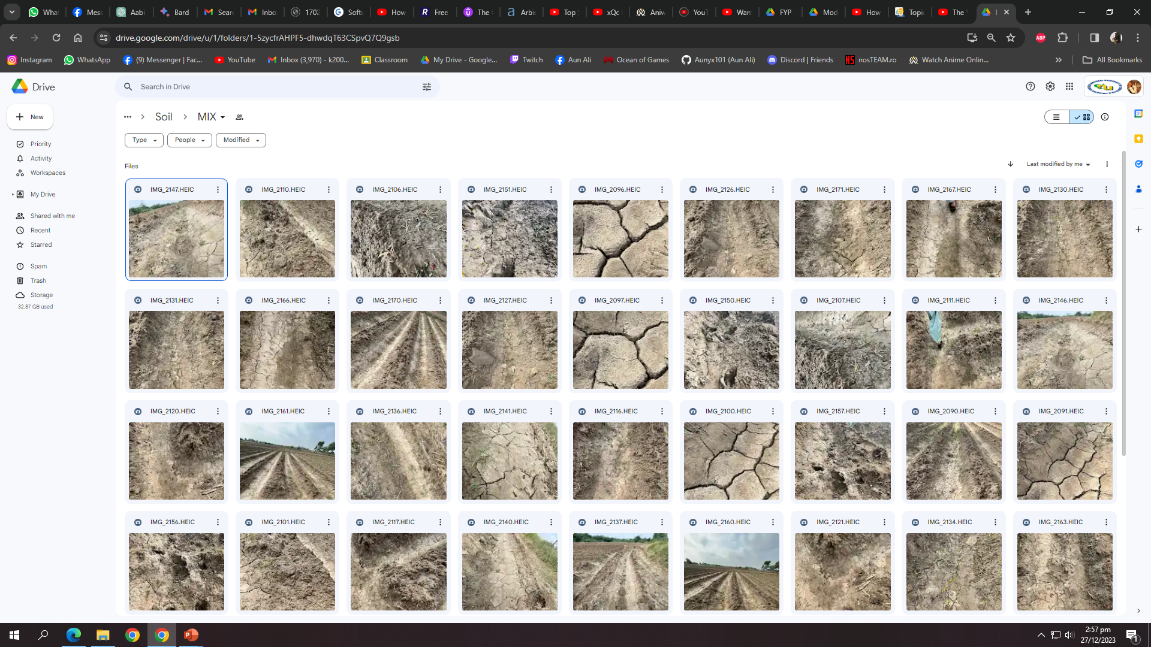

Slide 15
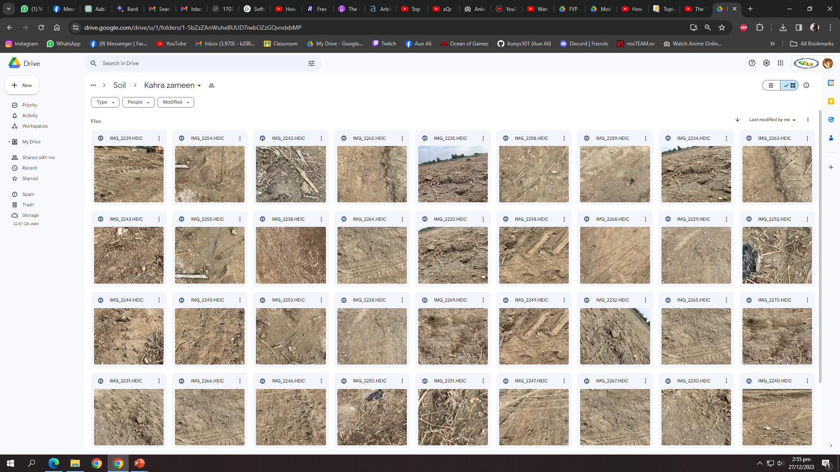

Slide 16
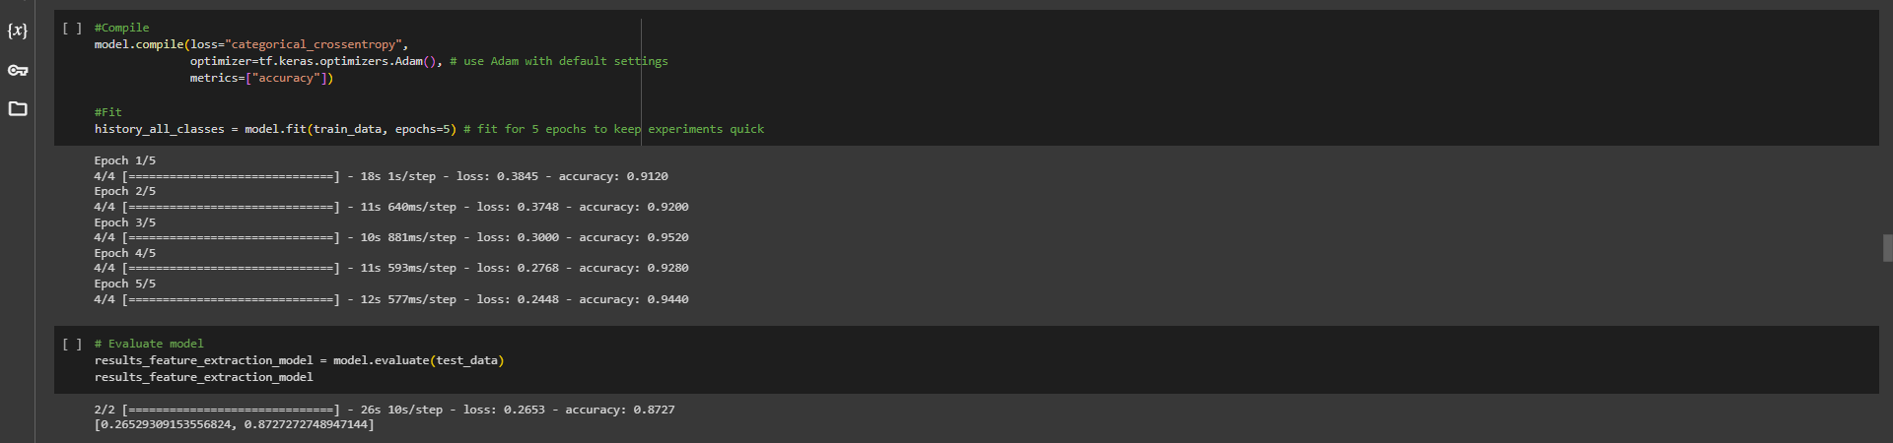
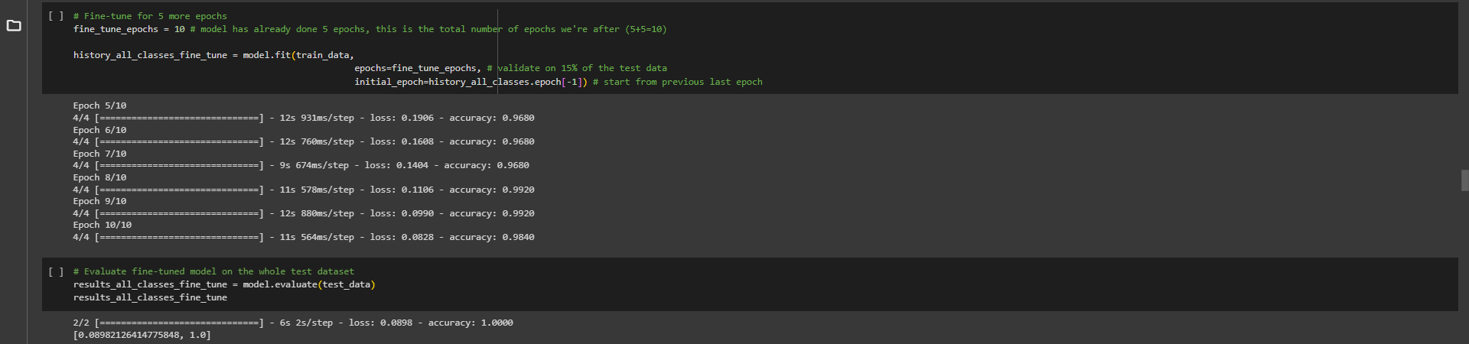
Soil Classification Model
Employed machine learning and computer vision techniques for soil classification.
Collected and analyzed data on soil types and nutrient requirements.

Slide 17
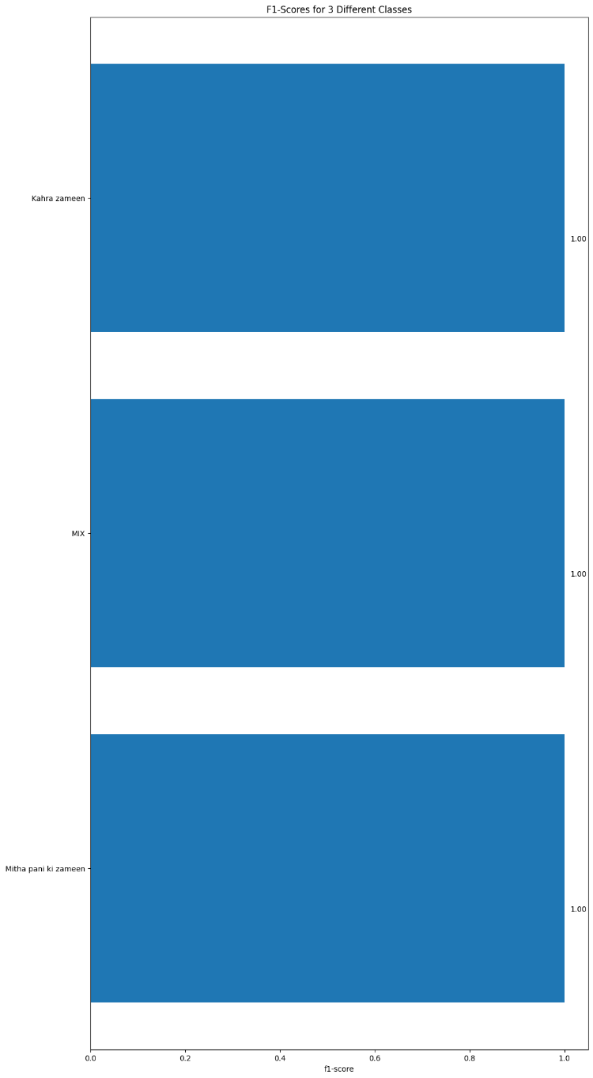
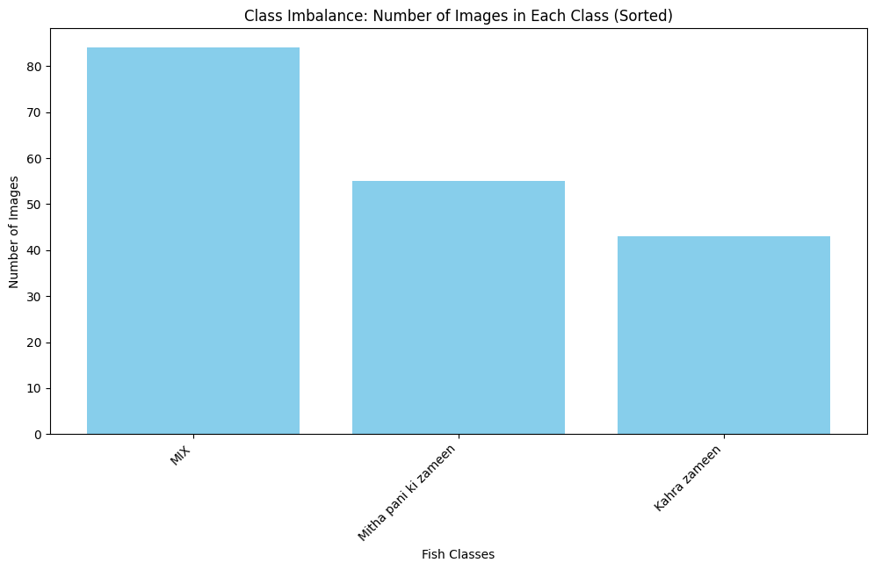
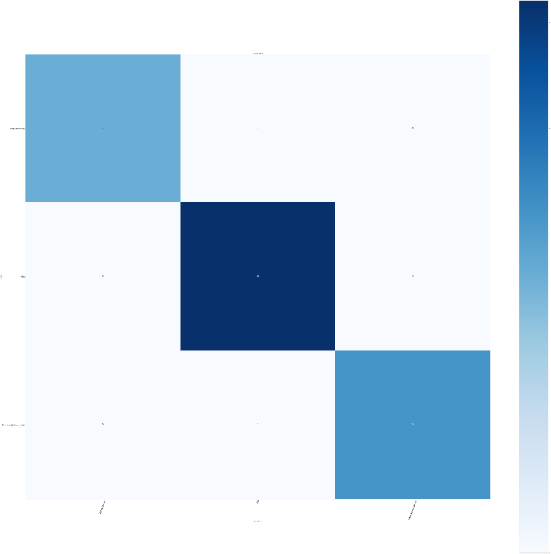
Soil Classification Model Results
Khara Paani
Khara Paani
MIX
MIX
Meetha Paani
Meetha Paani
▲Class Imbalance Diagram
▲Confusion Matrix
▲F1-Score Graph

Slide 18
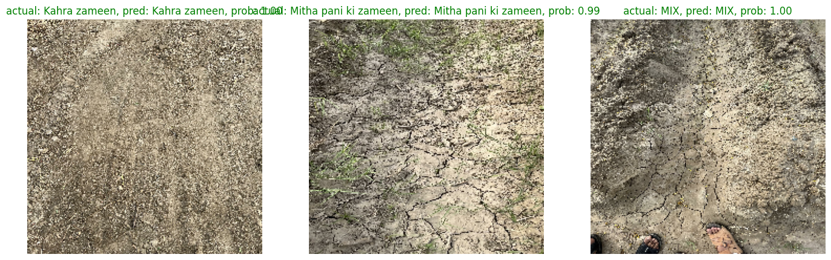
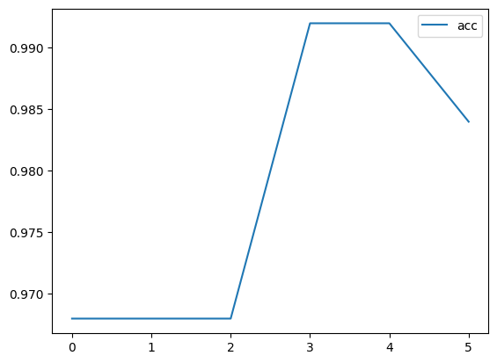
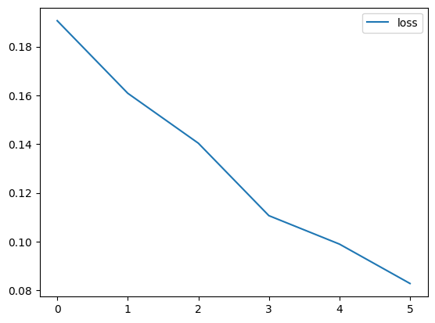
Soil Classification Model Results Continued
▲Model’s Prediction
▲Model’s Accuracy Graph
▲Model’s Loss Graph

Slide 19
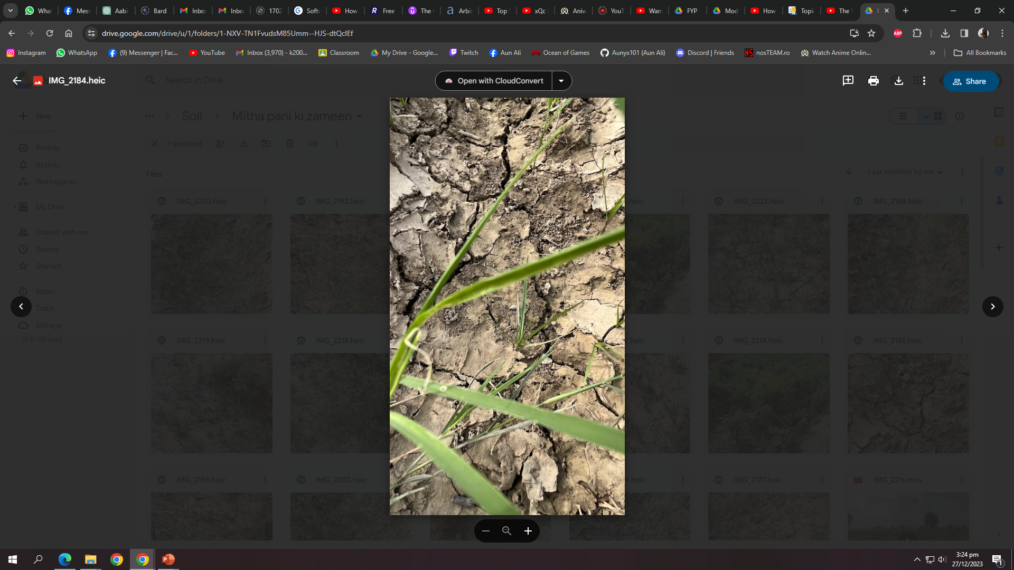
Soil Classification Methodology Flow Diagram
Dataset
Feature Extraction
Deep Learning Models
Trained Models
Training
Testing
Train Set
Testing Processing
Pre-Processing
Trained Models
Model Performance Evaluation
Classification
Meetha Paani
Train Set
Testing Processing
Fig 1 Block Diagram of the proposed methodology

Slide 20
Fish to Soil (& Vice Versa) Mapper
1. Data Linkage:
- Curated data capturing the relationship between different fish types and their corresponding ideal soil types.
- Organized and stored in an Excel file for ease of access.
2. Model Implementation:
- Utilized the Random Tree Classifier model for learning analysis.
3. Recommendation System:
- Resulting output functions as a recommendation system.
- Offers insights into the optimal soil types for a given fish species.
4. Soil-To-Fish Mapping:
- Enables visualized mapping, providing recommendations for soil-to-fish relationship.
- Enhances precision in agricultural decision-making and fosters sustainability in aquaculture.

Slide 21
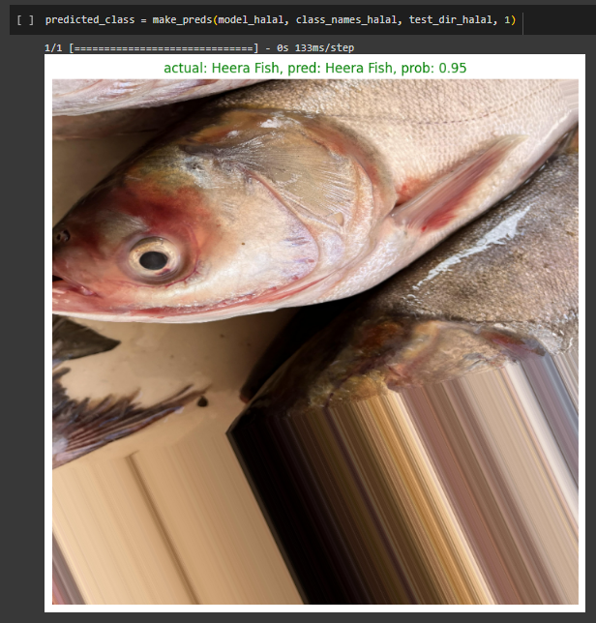
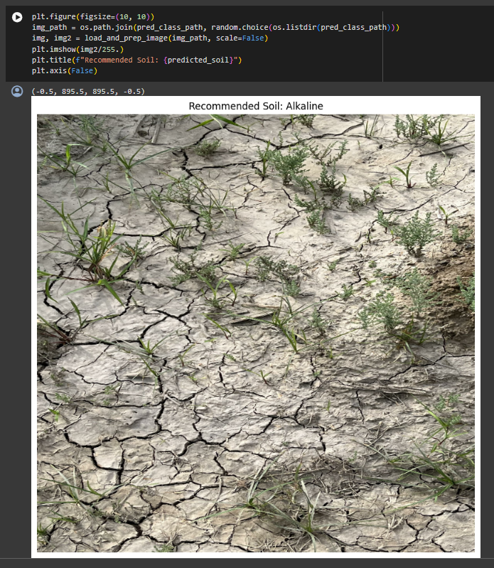
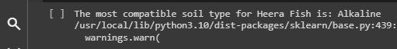
Mapper Continued
1: Fish Input After Prediction
2: Model Output
3: Model Mapped

Slide 22
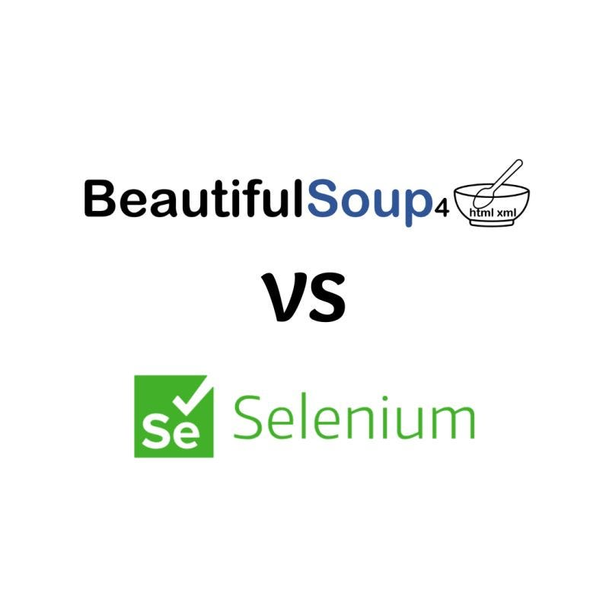
Fish Details At Classification
- Process:
- Use Selenium to navigate the website and identify relevant HTML elements.
- Employ BeautifulSoup to extract desired data from HTML content.
- Clean and process extracted data for further analysis.
- Adapt scraping code for website structure variations.
- Ensure robustness with error handling and retries.
- Benefits:
- Automate data extraction for efficiency.
- Enrich datasets with additional web-sourced information.
- Gain valuable insights into fish species and habitats.
&

Slide 23
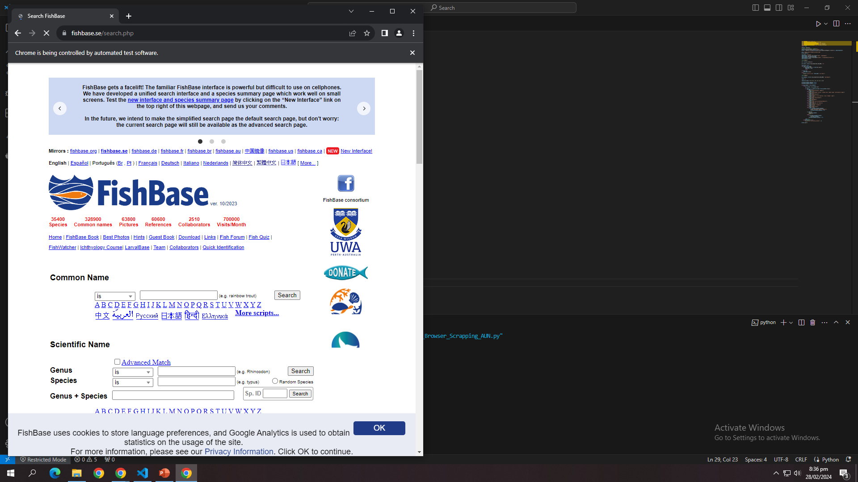

Slide 24
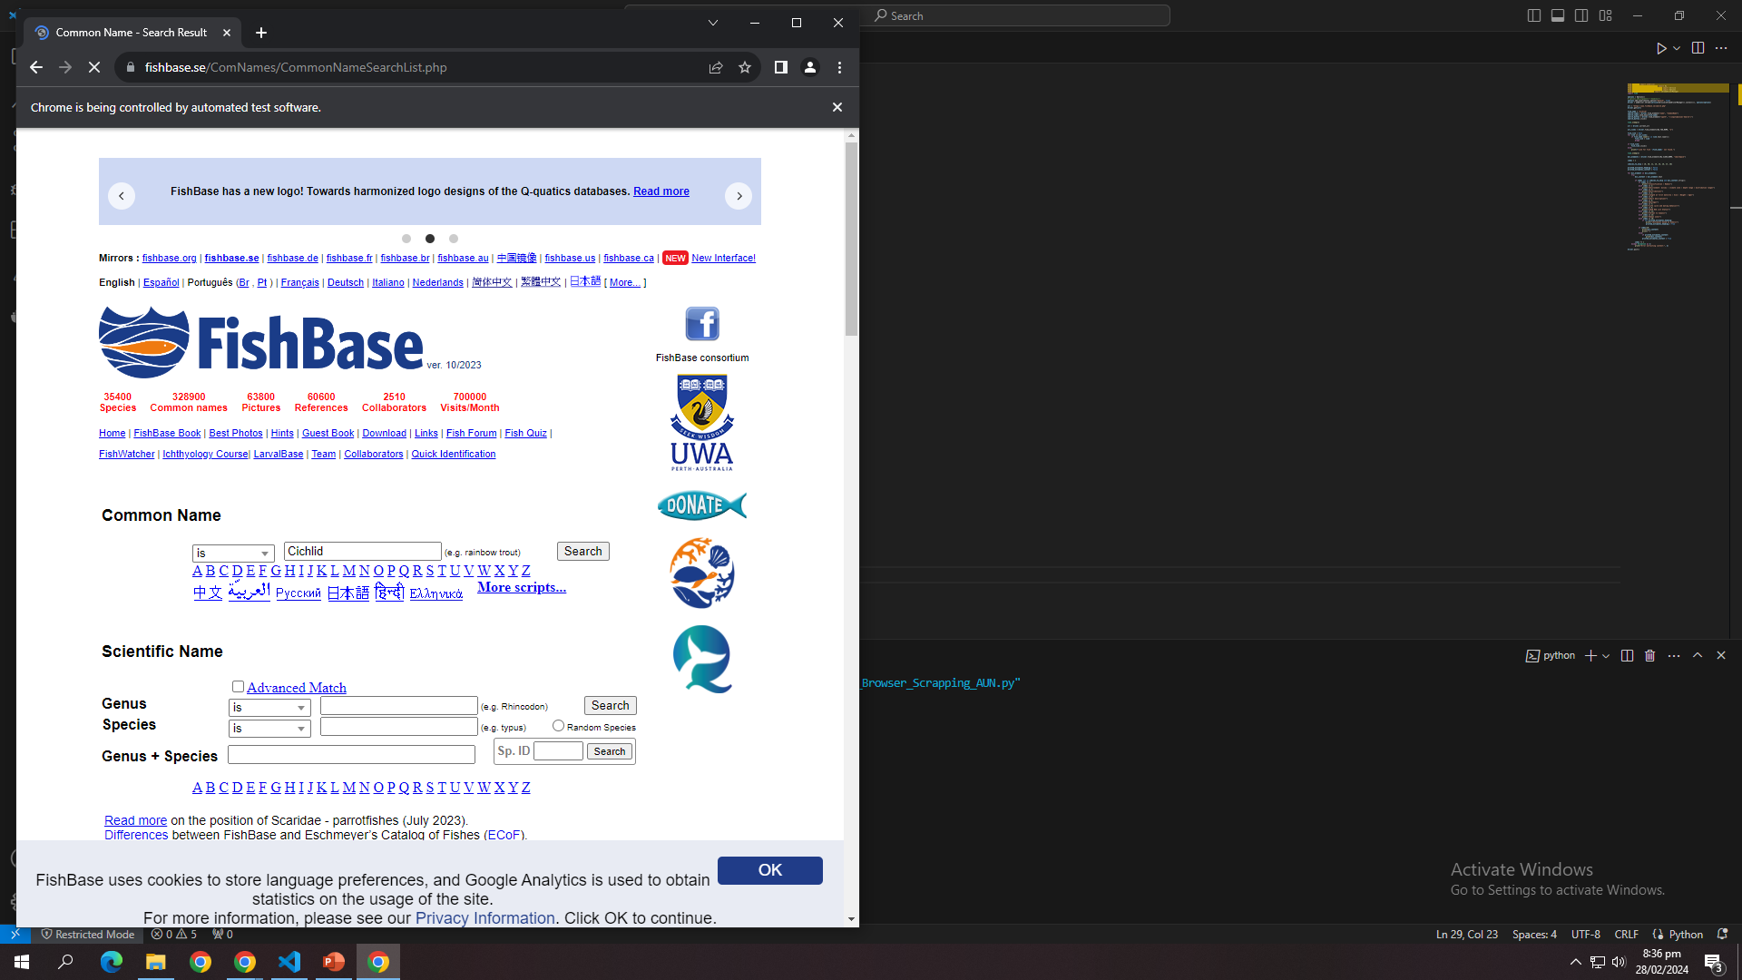

Slide 25
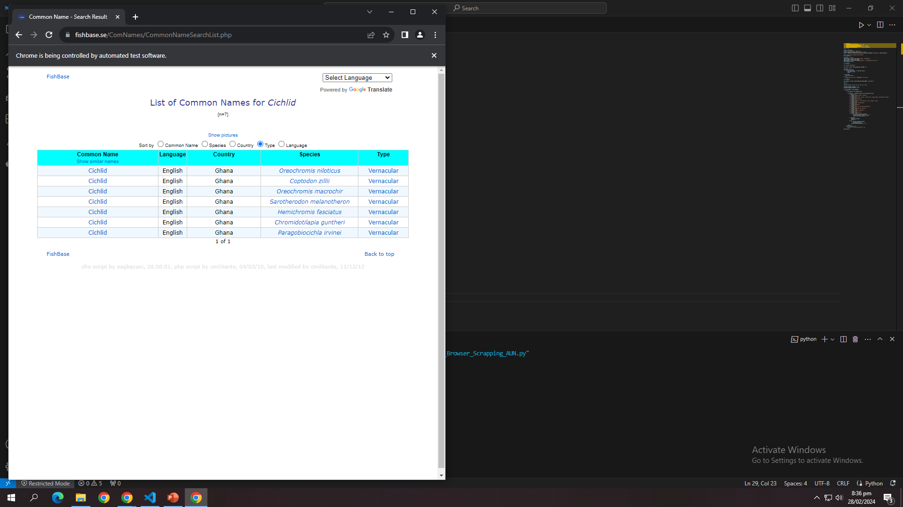

Slide 26
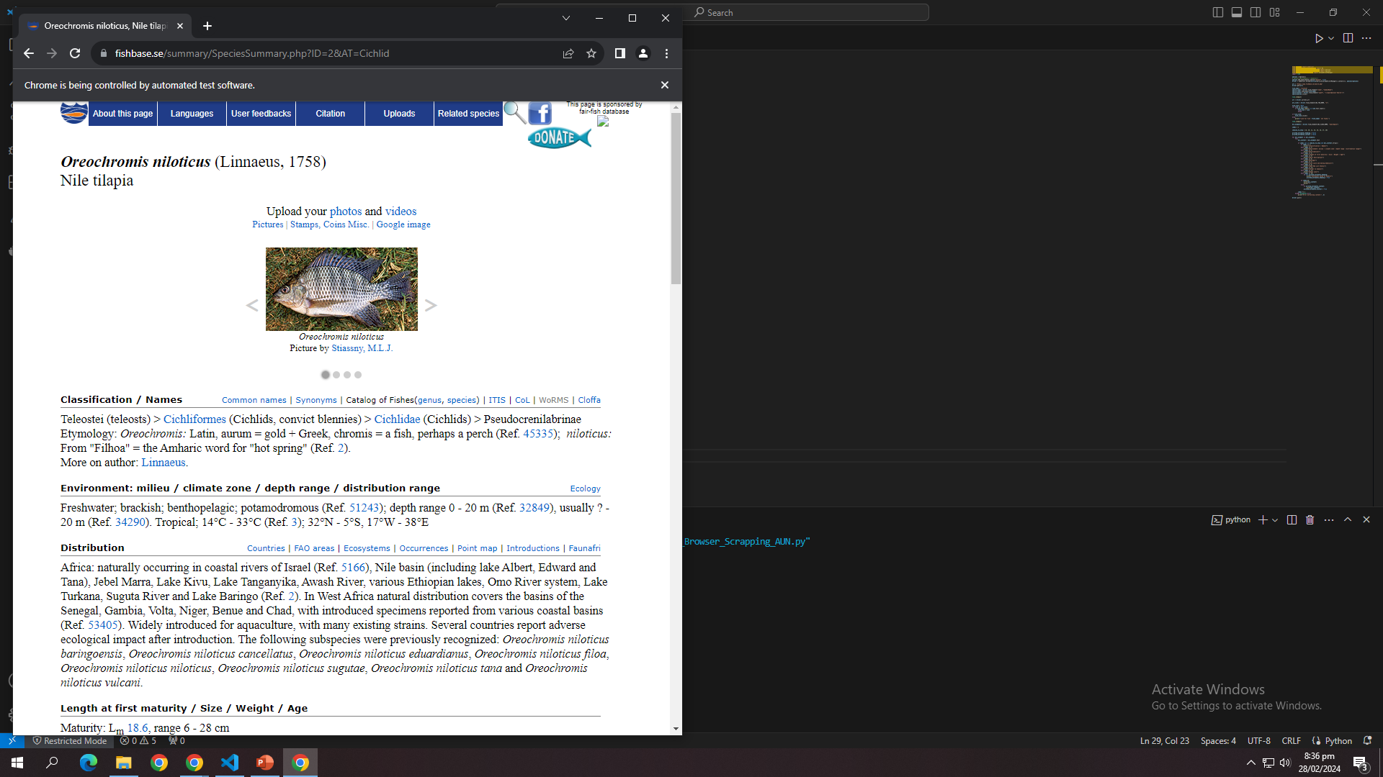

Slide 27
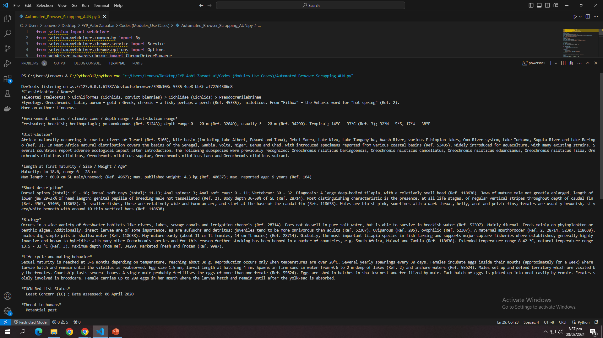
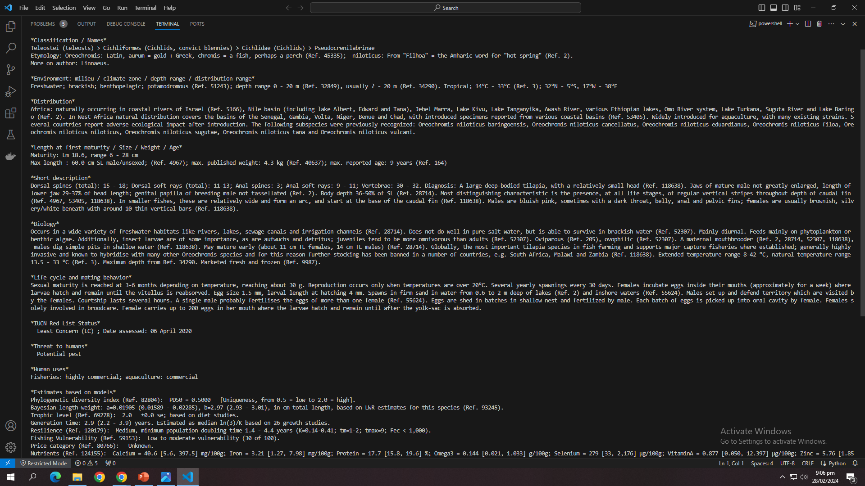

Slide 28
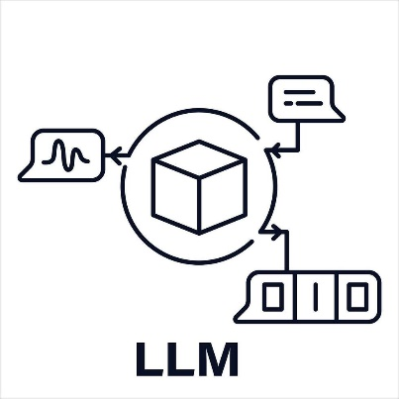


LLM For Nutrient Extraction Procedure
A language model tailored for recommending optimal methods to extract nutrients from fish.
- Process:
- Fine-tune the model on datasets related to fish nutrient extraction methods, equipment, and ingredients.
- Implement user input processing to understand specific requirements and constraints.
- Utilize the model to generate detailed recommendations based on user input.
- Ensure model comprehensively covers various extraction methods, equipment, and ingredients.
- Address potential limitations and constraints of different extraction techniques.
- Provide accurate and actionable recommendations tailored to user needs.
- Benefits:
- Improve efficiency and effectiveness of nutrient extraction processes from fish.
- Enhance decision-making by providing personalized and data-driven recommendations.
- Facilitate knowledge sharing and accessibility in the field of fish nutrition and food processing.

Slide 29
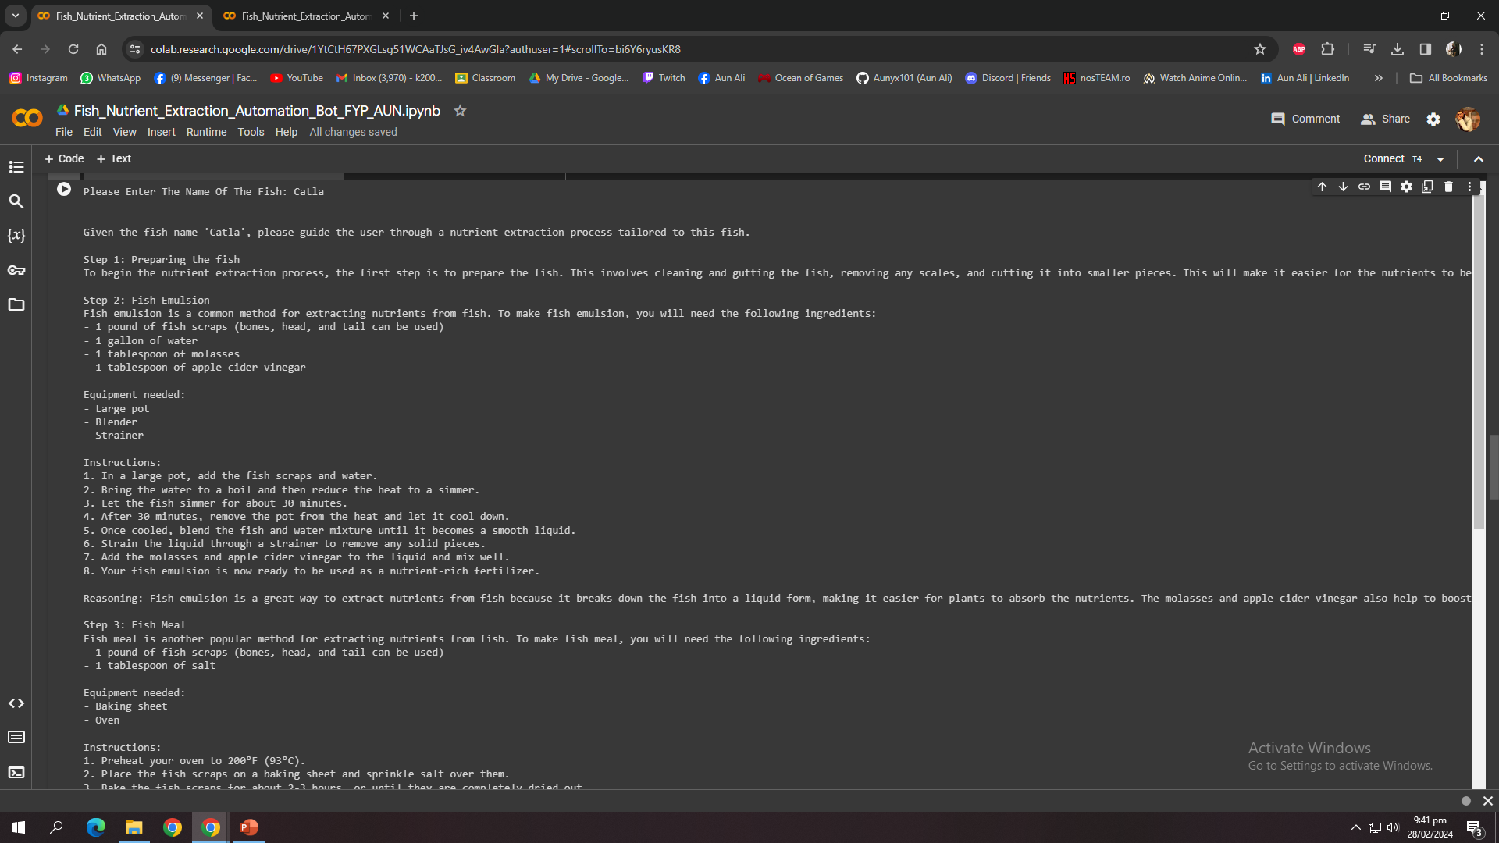

Slide 30
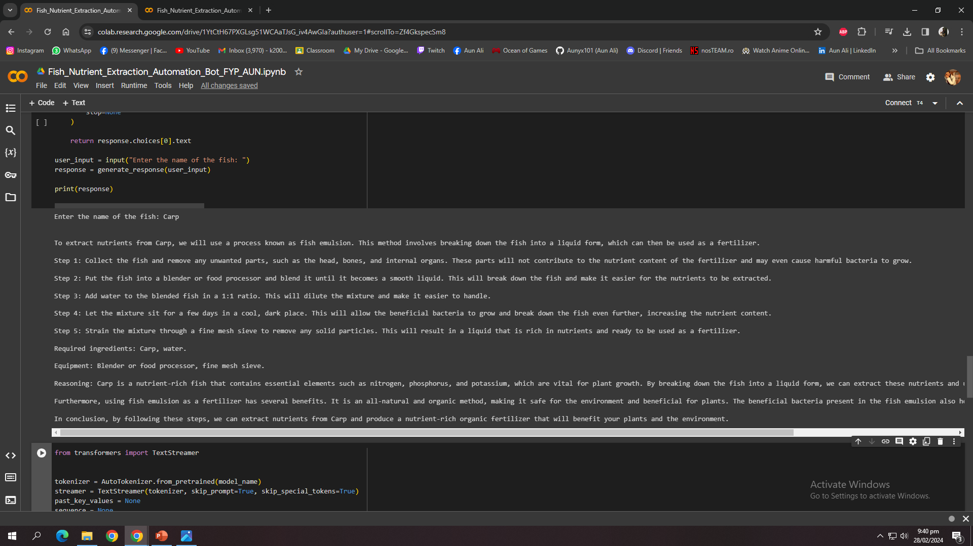

Slide 31
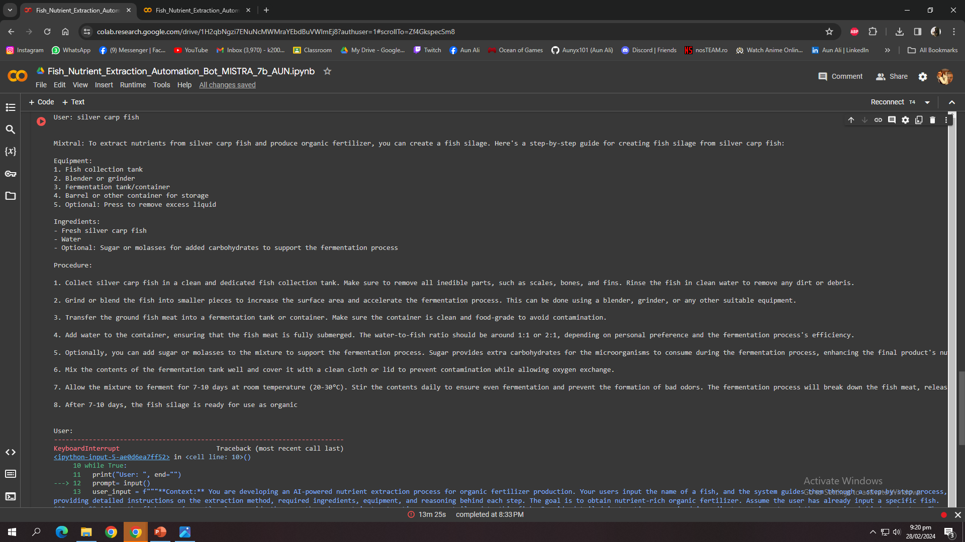

Slide 32
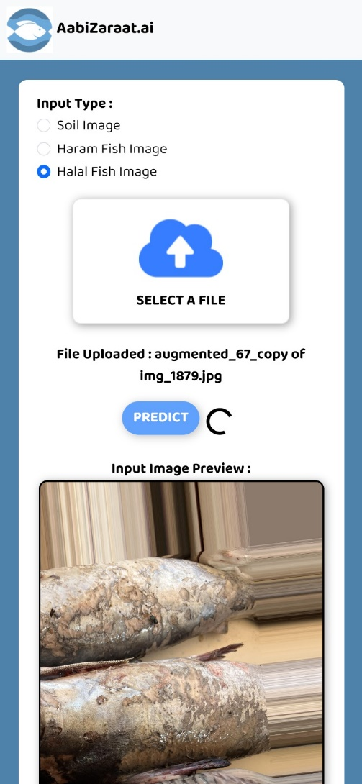
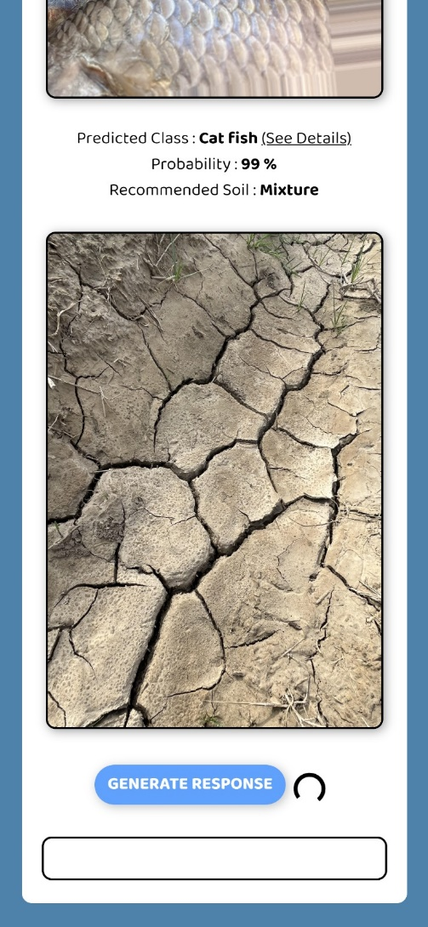



Frontend (User Interface)

Slide 33

Work Contribution To Society
Increased Crop Yields: The system will have the ability to recommend the most compatible and protein-rich fish species for soil enrichment, leading to soil fertility improvement. This, in turn, enhances crop yields, ensuring food security and economic stability for local communities.
Technology Adoption: Our application encourages the adoption of advanced technologies in agriculture and aquaculture, fostering digital literacy and technology-driven innovation in rural areas.
Data Collaboration: Aabi Zaraat.ai encourages collaboration with local communities and researchers to enhance and expand datasets related to fish species, soil types, and soil health monitoring. This collaborative approach benefits the broader research and aquacultural and agricultural community.

Slide 34

Documentation
Literature Review:
- In-Depth Exploration:
- Conducted an exhaustive review of existing literature to comprehend the nuances of fish and soil classification.
- Delved into scholarly articles, research papers, and publications relevant to the agricultural and aquaculture domains.
- Identified Research Gaps:
- Systematically identified gaps and areas lacking comprehensive exploration within the chosen research domain.
- Strategically positioned the project to contribute novel insights and methodologies.
- Technological Landscape:
- Explored the current technological landscape in the field of agricultural data analysis and AI-driven recommendation systems.
- Integrated contemporary technological advancements into the project's conceptual framework.

Slide 35



Documentation Continued
Baseline SRS and SDS:
- Functional Requirements (SRS):
- Clear definition of core application functionalities.
- Specifications for fish and soil classification, mapper, and user interactions.
- System Architecture (SDS):
- Overview of the system architecture, emphasizing module interactions.
- Database design for efficient storage and retrieval of data.
- User Interface (SDS):
- Design principles for a user-friendly interface.
- Intuitive navigation and presentation of information.
- Algorithmic Approach (SDS):
- Visualization of algorithms for fish and soil classification.
- Decision-making process of the recommendation system.

Slide 36

Documentation Continued
IEEE Paper: Brief Highlights
- Structure and Format:
- Adherence to IEEE format requirements for research papers.
- Proper organization with sections like Introduction, Methods, Results, and Conclusion.
- Methodology:
- Detailed explanation of the methodologies employed in the research.
- Rigorous application of IEEE citation style for accurate referencing.
- Results and Discussion:
- Presentation of results through figures, graphs, and tables.
- Insightful discussion on the implications and significance of the findings.

Slide 37

Conclusion
Potential areas for further research include real-time environmental data integration for soil health monitoring.
Expanding the fish health assessment capabilities and acquiring a suitable dataset for fish health analysis.
IAASES seeks to revolutionize agriculture in Pakistan by employing a versatile approach that integrates various techniques for soil enrichment. Our project encompasses the automation of multiple soil enrichment methods, promoting sustainability, and empowering farmers with technology-driven solutions.

Slide 38

THANK YOU! ANY QUESTIONS?

